Slide 1
CISCO Packet Tracer

Slide 2
Class C IP Address
A Class C IP address is a type of IP address used in small networks, such as home and small business networks.
Addresses are made up of 24 bits for the network address and 8 bits for the local host address.
The first three bits of the network address are always 110, and the remaining 21 bits are used to determine the network ID.
The first 8 bits of the host ID are used to identify the host on a given network.
Network size: Class C networks can support up to 254 hosts.
Address range: Class C IP addresses are in the range 192.0.0.0 to 223.255.255.255

Slide 3
PC1: 192.164.10.2
PC2: 192.164.10.3
PC3: 192.164.10.4
Net ID will be the same, but different host IDs

Slide 4
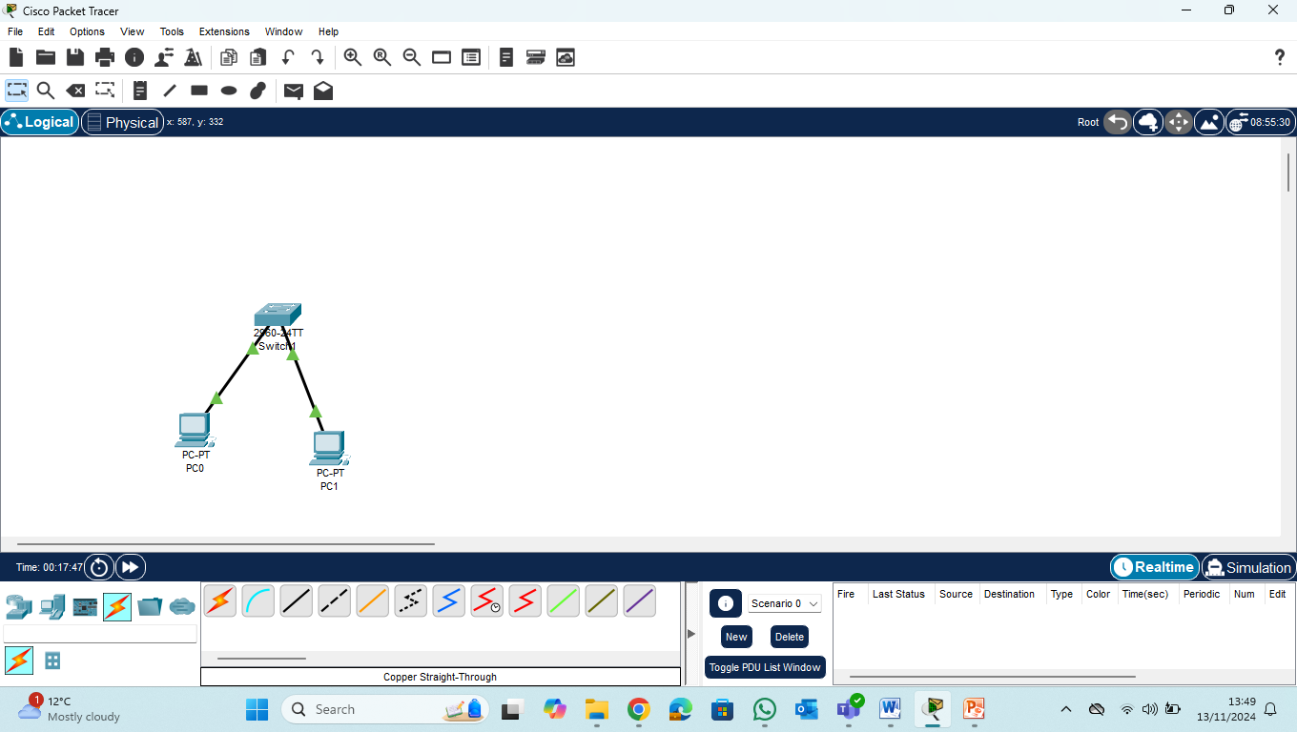

Slide 5
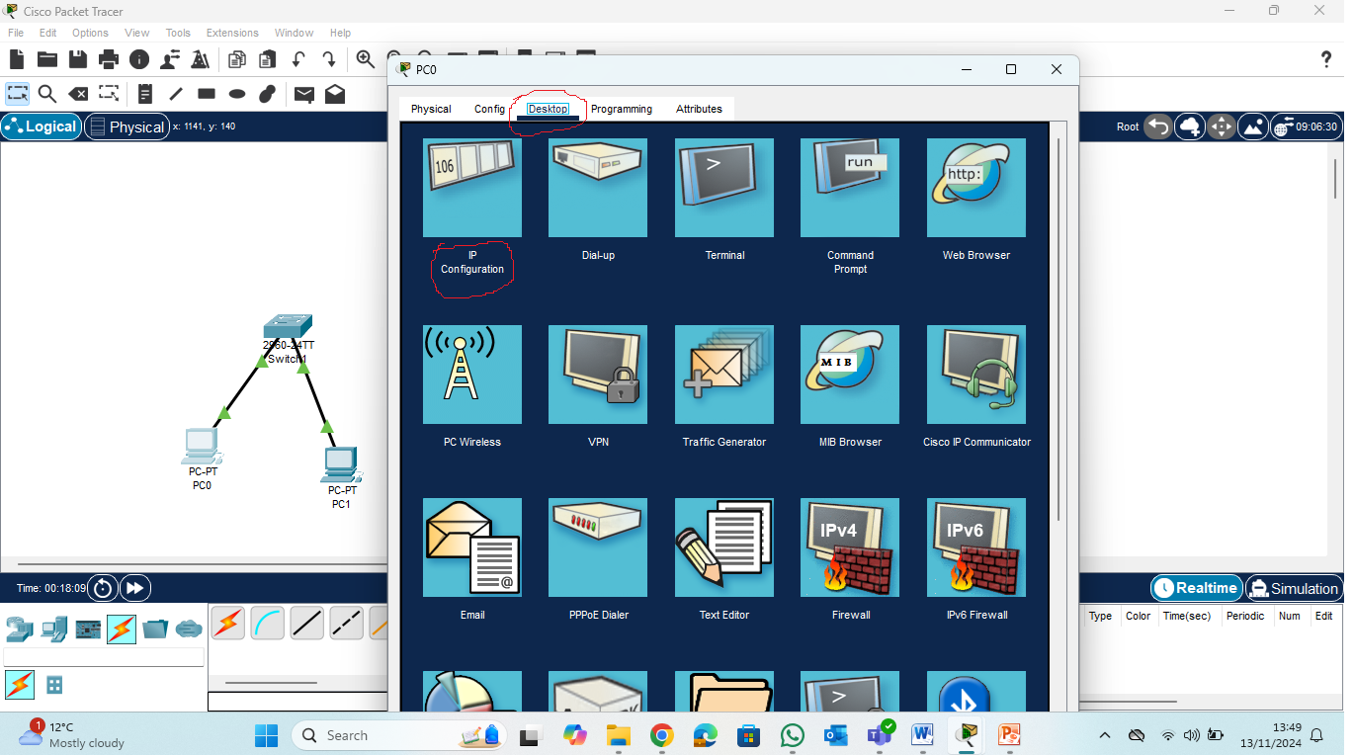
IP Address

Slide 6
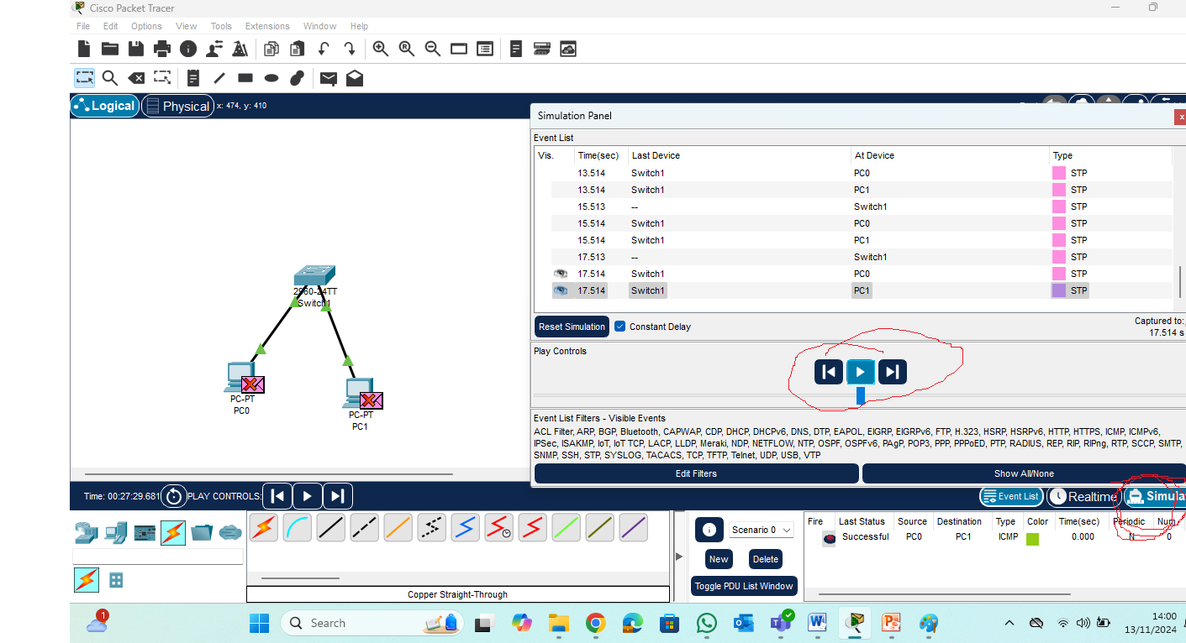
Simulation

Slide 7
Internet Control Message Protocol (ICMP) is a network layer protocol that allows devices to communicate data transmission issues.
What is STP and how does it work? Spanning Tree Protocol (STP) is a Layer 2 network protocol used to prevent looping within a network topology. STP was created to avoid the problems that arise when computers exchange data on a local area network (LAN) that contains redundant paths.

Slide 8
Change N/W address
PC1: 192.164.10.2
PC2: 192.164.10.3
If we change the network address
Switch will not be able to make communication possible between the PCs
Ping on command prompt from PC0 to PC1

Slide 9
Lab 8 – Part 1
Switch Port Security PKT.pkt (in Week 7)

Slide 10
Configure Port Security
Access the command line for S1 and enable port security on Fast Ethernet ports 0/1 and 0/2.
S1>enable
S1#confi
S1#configure
Configuring from terminal, memory, or network [terminal]? terminal
Enter configuration commands, one per line. End with CNTL/Z.
S1(config)#interface range fa0/1 - 2
S1(config-if-range)#switch
S1(config-if-range)#switchport port
S1(config-if-range)#switchport port-security
S1(config-if-range)#

Slide 11
Configure Port Security
Set the maximum so that only one device can access the Fast Ethernet ports 0/1 and 0/2.
S1(config-if-range)# switchport port-security maximum 1
Secure the ports so that the MAC address of a device is dynamically learned and added to the running configuration.
S1(config-if-range)# switchport port-security mac-address sticky
Set the violation so that the Fast Ethernet ports 0/1 and 0/2 are not disabled when a violation occurs, but a notification of the security violation is generated and packets from the unknown source are dropped.
S1(config-if-range)# switchport port-security violation restrict

Slide 12
Configure Port Security
Disable all the remaining unused ports. Hint: Use the range keyword to apply this configuration to all the ports simultaneously.
S1(config-if-range)# exit
S1(config-if-range)# interface range fa0/3 - 24 , gi1/1 – 2
Comment: instead of gi1/1 – 2, it may be gi0/1 – 2
S1(config-if-range)# shutdown

Slide 13
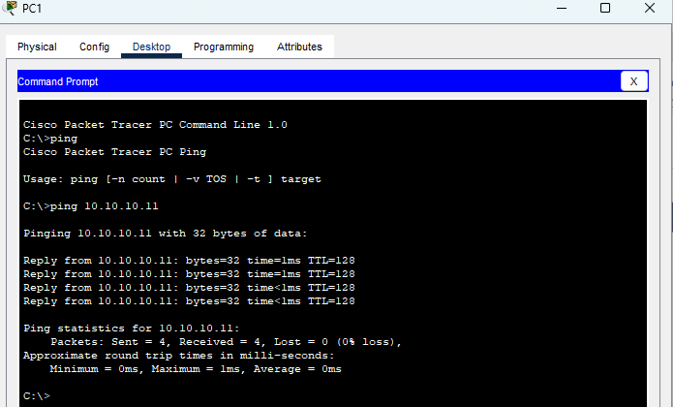
Part 2: Verify the ports
From PC1, ping PC2.

Slide 14
Part 2: Verify the ports
Verify port security is enabled and the MAC addresses of PC1 and PC2 were added to the running configuration.
S1#show port-security interface fa0/2
Port Security : Enabled
Port Status : Secure-up
Violation Mode : Restrict
Aging Time : 0 mins
Aging Type : Absolute
SecureStatic Address Aging : Disabled
Maximum MAC Addresses : 1
Total MAC Addresses : 1
Configured MAC Addresses : 0
Sticky MAC Addresses : 1
Last Source Address:Vlan : 0030.A331.4D2B:1
Security Violation Count : 0

Slide 15
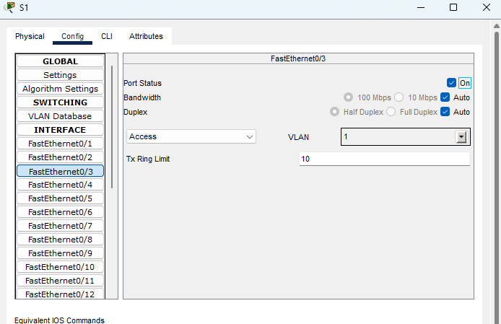
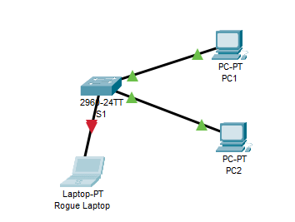
Part 2: Verify the ports
Attach Rogue Laptop to any unused switch port and notice that the link lights are red.
Enable the port and verify that Rogue Laptop can ping PC1 and PC2. After verification, shut down the port connected to Rogue Laptop.

Slide 16
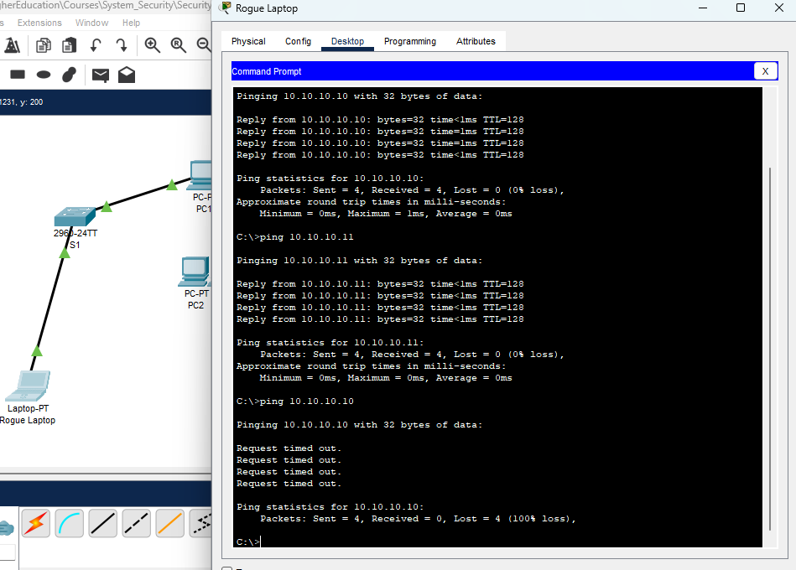
Part 2: Verify the ports
Disconnect PC2 and connect Rogue Laptop to PC2’s port. Verify that Rogue Laptop is unable to ping PC1.
Display the port security violations for the port Rogue Laptop is connected to.
S1# show port-security interface fa0/2

Slide 17
Part 2: Verify the ports
Disconnect Rouge Laptop and reconnect PC2. Verify PC2 can ping PC1.
Why is PC2 able to ping PC1, but the Rouge Laptop is not? The port security that was enabled on the port only allowed the device, whose MAC was learned first, access to the port while preventing all other devices access.

Slide 18
Lab 8 – Part 2 from the pdf
SSH PKT.pkt

Slide 19
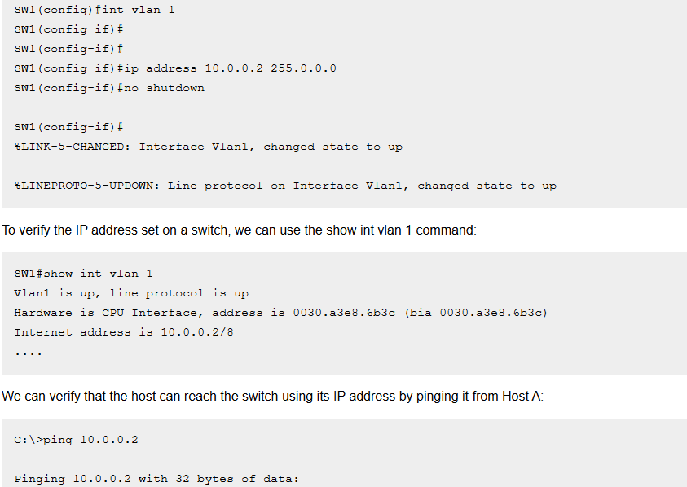
Configure IP in Switch

Slide 20
Telnet, or Teletype Network, is a network protocol that allows users to access remote computers and communicate with them using a command line interface.

Slide 21
Routers
Lab Week 9

Slide 22
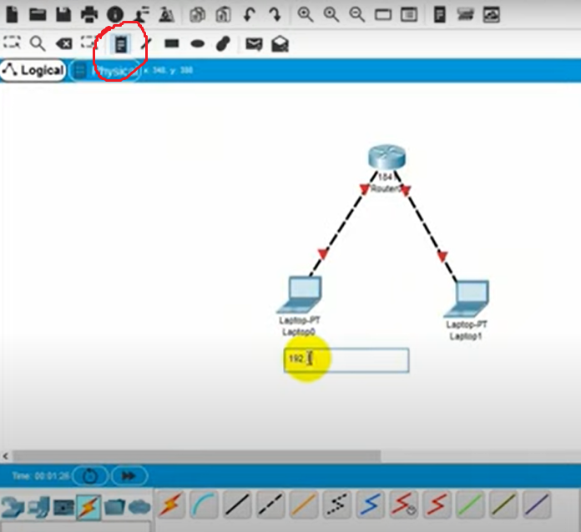
End devices with router 1841 and cross copper
Get IP address
as note
192.167.1.2
192.167.2.2
Creating two
Different N/W
Configure the same
address

Slide 23
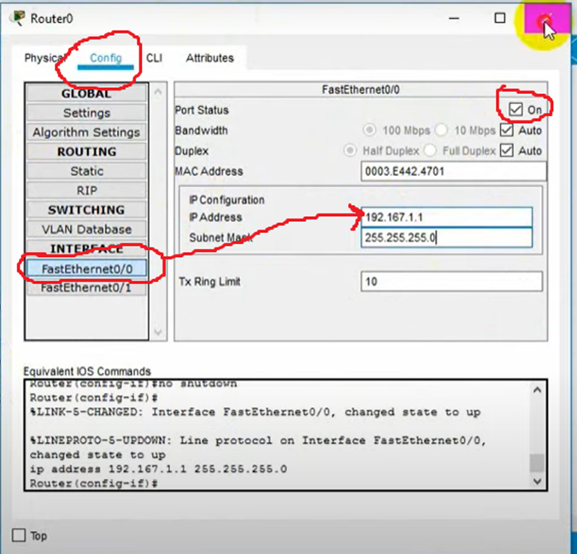
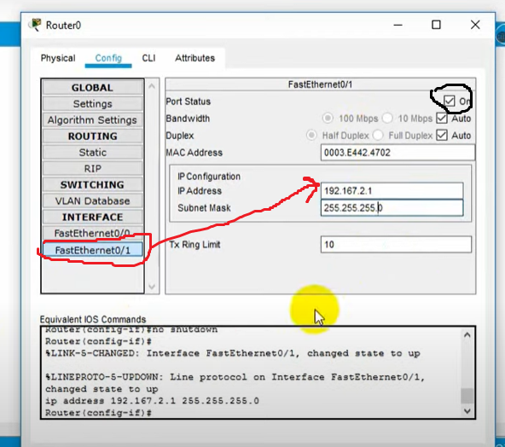
Configure the Router

Slide 24
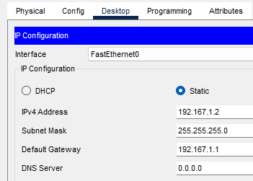
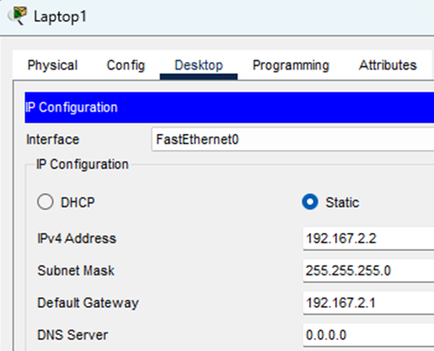
Configure Router
Put the router addresses in the gateway addresses of the respective end devices

Slide 25
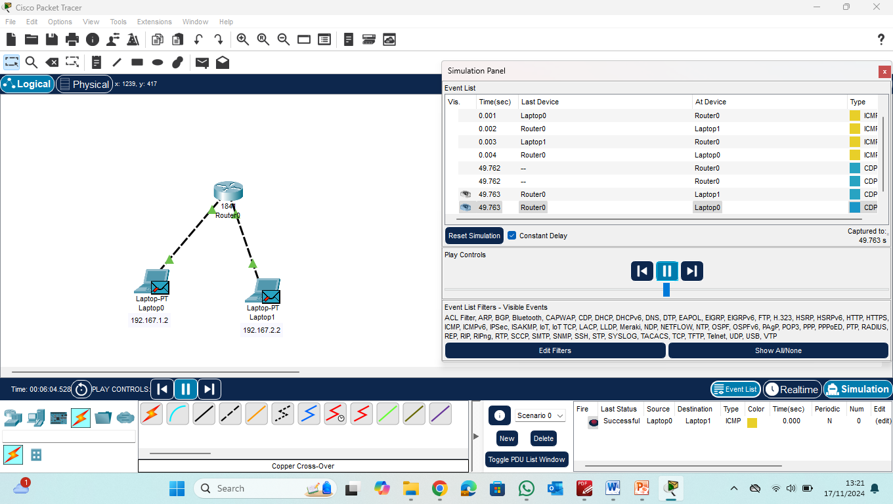
Simulation

Slide 26
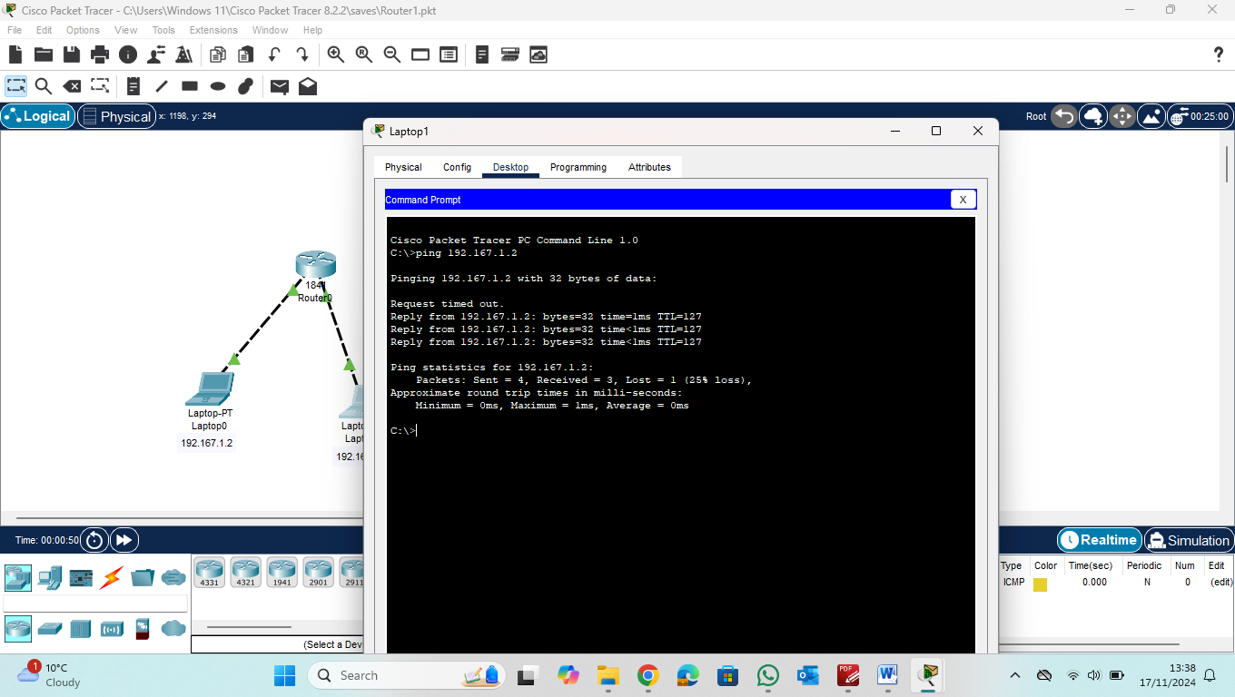
Ping

Slide 27
Week 9 lab – part 1
ACL part1-PT.pkt

Slide 28
Objectives
In this activity, you will observe how an access control list (ACL) can be used to prevent a ping from reaching hosts on remote networks.
After removing the ACL from the configuration, the pings will be successful.
Part 1: Verify Local Connectivity and Test Access Control List
Part 2: Remove Access Control List and Repeat Test

Slide 29
Addressing Table
Device | Interface | IP Address / Prefix
R1 | G0/0 | 192.168.10.1/24
 | G0/1 | 192.168.11.1/24
 | S0/0/0 | 10.1.1.1/30
R2 | S0/0/0 | 10.10.1.2/30
 | S0/0/1 | 10.10.1.5/30
R3 | G0/0 | 192.168.30.1/24
 | G0/1 | 192.168.31.1/24
 | S0/0/1 | 10.10.1.6/24
PC1 | NIC | 192.168.10.10/24
PC2 | NIC | 192.168.10.11/24
PC3 | NIC | 192.168.11.10/24
PC4 | NIC | 192.168.30.12/24
DNS Server | NIC | 192.168.31.12/24
The prefix is shown as a number after a slash, like “/24,“ which tells how many bits are used for the network. A shorter prefix gives more addresses to devices but fewer networks, while a longer prefix gives more networks but fewer addresses

Slide 30
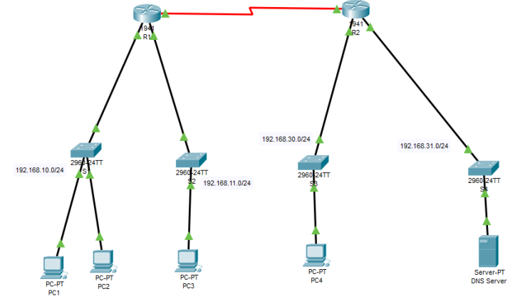
The Topology

Slide 31
Part 1: Check Connectivity
Before applying any ACLs to a network, it is important to confirm that we have full connectivity.
Verify that the network has full connectivity by choosing a PC and pinging other devices on the network (or by route tracing).
A confirmation can be in the form of being be able to successfully ping every device.

Slide 32
Part 1: Verify ACL
An access control list (ACL) can be used to prevent a ping (instead of pinging you may prefer route tracing) from reaching hosts on remote networks.
We may need to find out where the ACL is configured and remove it if necessary.
Verify Local Connectivity and Test Access Control List

Slide 33
Part 1: Step 1
Step 1: Ping devices on the local network to verify connectivity.
From the command prompt of PC1, ping PC2 (both are in the same LAN);
and from the command prompt of PC1, ping PC3 (in two different LANs / segments).
Why were the pings successful?
There is no policy filtering ICMP (Internet Control Messaging Protocol) messages (and any other protocol message) between the two local networks.
There is nothing restricting layers 1,2, and 3 technology and protocols, functions or services. (physical, data link, and network layers)

Slide 34
Part 1: Step 2
Ping devices on remote networks to test ACL functionality.
From the command prompt of PC1, ping PC4 (which is in a remote network);
and from the command prompt of PC1, ping the DNS Server (the DNS server is also in a remote network).
Why did the pings fail? Where did the pings stop? (Hint: Use simulation mode or view the router configurations to investigate.)
You may also repeat these steps and use PC2 to ping PC4 and DNS Server.
The pings fail because R1 is configured with an ACL that denies any ping from exiting the serial 0/0/0 interface. This ACL does not affect 192.168.11.0/24. (S0/0/0 means the serial interface on slot 0, card 0, port 0)

Slide 35
Part 2: Remove ACL and Repeat Test
Step 1: Use show commands to investigate the ACL configuration. (a)
Navigate to R1 CLI
To quickly view the current ACLs, use show access-lists.
Enter the show access-lists command, followed by a space and a question mark (?) to view the available options:
Enter
R1>enable
R1#show access-lists ? (? Help)
<1-199> ACL number
WORD ACL name
<cr>
---
R1#show access-lists
Standard IP access list 11
10 deny 192.168.10.0 0.0.0.255 (This rule blocks all traffic from the subnet 192.168.10.0/24.)
20 permit any (This rule allows all other traffic to pass.)

Slide 36
Part 2: Remove ACL and Repeat Test
If you know the ACL number or name, you can filter the show output further.
However, R1 only has one ACL; therefore, the show access-lists command will suffice.
R1#show access-lists
Standard IP access list 11
10 deny 192.168.10.0 0.0.0.255
20 permit any
Can you explain what this ACL can do? Link you answer to the wildcard used (0.0.0.255 – what does such mask do?)
The first line of the ACL prevents any packets originating in the 192.168.10.0/24 network, which includes Internet Control Message Protocol (ICMP) echoes (ping requests). The second line of the ACL allows all other IP traffic from any source to transverse the router.

Slide 37
Part 2: Remove ACL and Repeat Test
(b) Optional
For an ACL to impact router operation, it must be applied to an interface in a specific direction.
In this scenario, the ACL is used to filter traffic exiting an interface.
Therefore, all traffic leaving the specified interface of R1 will be inspected against ACL 11.
Use show running-config to yet view this ACL in the running configuration file? You should also see in which direction the ACP is applied. You can also use the command show ip interface to get such information. Outgoing traffic on S0/0/0. (all the red slides)

Slide 38
Part 2: Remove ACL and Repeat Test
(b) Optional
Although you can view IP information with the show ip interface command, it may be more efficient in some situations to simply use the show run command.
To obtain a complete list of interfaces that the ACL that may be applied to, and the list of all ACLs that are configured, use the following command:

Slide 39
Part 2: Remove ACL and Repeat Test
R1# show run | include interface|access
interface GigabitEthernet0/0
interface GigabitEthernet0/1
interface Serial0/0/0
ip access-group 11 out
interface Serial0/0/1
interface Vlan1
access-list 11 deny 192.168.10.0 0.0.0.255
access-list 11 permit any
1) Interfaces Configuration:
The router has multiple interfaces:
GigabitEthernet0/0
GigabitEthernet0/1
Serial0/0/0
Serial0/0/1
Vlan1 (likely a management VLAN)
2) Access Control List (ACL) Implementation:
An ACL numbered 11 is created.
The rule access-list 11 deny 192.168.10.0 0.0.0.255 blocks all traffic from the subnet 192.168.10.0/24.
The rule access-list 11 permit any allows all other traffic.
3) Applying the ACL:
The ACL 11 is applied outbound on Serial0/0/0 using ip access-group 11 out, meaning traffic leaving this interface is filtered based on the ACL.

Slide 40
Part 2: Remove ACL and Repeat Test
The second pipe symbol ‘|” creates an OR condition that matches ‘interface’ OR ‘access’. It is important that no spaces are included in the OR condition. Use one or both of these commands to find information about the ACL.
To which interface and in what direction is the ACL applied?
Serial 0/0/0, outgoing traffic

Slide 41
Part 2: Remove Access List 11
Step 2: Remove access list 11 from the configuration
You can remove ACLs from the configuration by issuing the no access list [number of the ACL] command.
The no access-list command deletes all ACLs configured on the router. The no access-list [number of the ACL] command removes only a specific ACL.

Slide 42
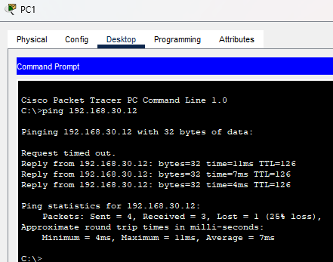
Part 2: Remove Access List 11
Under the Serial0/0/0 interface, remove access-list 11 previously applied to the interface as an outgoing filter:
R1#configure
R1(config)# int se0/0/0
R1(config-if)#no ip access-group 11 out
In global configuration mode, remove the ACL by entering the following command:
R1(config)# no access-list 11
Verify that PC1 can now ping the DNS Server and PC4.

Slide 43
Week 9 lab – part 2
Configuring IP4 acl

Slide 44
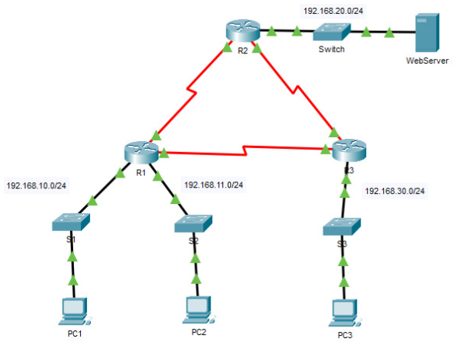
topology

Slide 45
Addressing table
Device | Interface | IP Address | Subnet Mask | Default Gateway
R1 | G0/0 | 192.168.10.1 | 255.255.255.0 | N/A
 | G0/1 | 192.168.11.1 | 255.255.255.0
 | S0/0/0 | 10.1.1.1 | 255.255.255.252
 | S0/0/1 | 10.3.3.1 | 255.255.255.252
R2 | G0/0 | 192.168.20.1 | 255.255.255.0 | N/A
 | S0/0/0 | 10.1.1.2 | 255.255.255.252
 | S0/0/1 | 10.2.2.1 | 255.255.255.252
R3 | G0/0 | 192.168.30.1 | 255.255.255.0 | N/A
 | S0/0/0 | 10.3.3.2 | 255.255.255.252
 | S0/0/1 | 10.2.2.2 | 255.255.255.252
PC1 | NIC | 192.168.10.10 | 255.255.255.0 | 192.168.10.1
PC2 | NIC | 192.168.11.10 | 255.255.255.0 | 192.168.11.1
PC3 | NIC | 192.168.30.10 | 255.255.255.0 | 192.168.30.1
WebServer | NIC | 192.168.20.254 | 255.255.255.0 | 192.168.20.1

Slide 46
objectives
Standard access control lists (ACLs) are router configuration scripts that control whether a router permits or denies packets based on the source address.
This activity focuses on defining filtering criteria, configuring standard ACLs, applying ACLs to router interfaces, and verifying and testing the ACL implementation.
The routers are already configured, including IP addresses and Enhanced Interior Gateway Routing Protocol (EIGRP) routing.
Part 1: Plan an ACL Implementation
Part 2: Configure, Apply, and Verify a Standard ACL

Slide 47
Instructions
Part 1: Plan an ACL Implementation
Step 1: Investigate the current network configuration.
Before applying any ACLs to a network, it is important to confirm that you have full connectivity.
Verify that the network has full connectivity by choosing a PC and pinging other devices on the network.
You should be able to successfully ping every device.

Slide 48
Instructions
Part 1: Plan an ACL Implementation
Step 2: Evaluate two network policies and plan ACL implementations.
a. The following network policies are implemented on R2:
The 192.168.11.0/24 network is not allowed access to the WebServer on the 192.168.20.0/24 network.
All other access is permitted.
To restrict access from the 192.168.11.0/24 network to the WebServer at 192.168.20.254 without interfering with other traffic, an ACL must be created on R2.
The access list must be placed on the outbound interface to the WebServer.
A second rule must be created on R2 to permit all other traffic.

Slide 49
Instructions
Part 1: Plan an ACL Implementation
Step 2: Evaluate two network policies and plan ACL implementations.
b. The following network policies are implemented on R3:
The 192.168.10.0/24 network is not allowed to communicate with the 192.168.30.0/24 network.
All other access is permitted.
To restrict access from the 192.168.10.0/24 network to the 192.168.30/24 network without interfering with other traffic, an access list will need to be created on R3.
The ACL must be placed on the outbound interface to PC3. A second rule must be created on R3 to permit all other traffic.

Slide 50
Solution
Part 1: Plan an ACL Implementation
Step 1: Investigate the current network configuration.
Before applying any ACLs to a network, it is important to confirm that you have full connectivity.
Verify that the network has full connectivity by choosing a PC and pinging other devices on the network.
You should be able to successfully ping every device.
From command line of PC1 ping to PC2 and PC3
C:\>ping 192.168.11.10
C:\>ping 192.168.30.10

Slide 51
Solution
Part 2:Configure, Apply, and Verify a Standard ACL
Step 1: Configure and apply a numbered standard ACL on R2.
a. Create an ACL using the number 1 on R2 with a statement that denies access to the 192.168.20.0/24 network from the 192.168.11.0/24 network.
Go to R2 and select CLI
R2>enable
R2#configure
Configuring from terminal, memory, or network [terminal]? terminal
Enter configuration commands, one per line. End with CNTL/Z.
R2(config)#access-list 1 deny 192.168.11.0 0.0.0.255
b. By default, an access list denies all traffic that does not match any rules. To permit all other traffic, configure the following statement:
R2(config)# access-list 1 permit any
c. Before applying an access list to an interface to filter traffic, it is a best practice to review the contents of the access list, in order to verify that it will filter traffic as expected.
R2# show access-lists
Standard IP access list 1
10 deny 192.168.11.0 0.0.0.255
20 permit any

Slide 52
Solution
Part 2:Configure, Apply, and Verify a Standard ACL
Step 1: Configure and apply a numbered standard ACL on R2.
d. For the ACL to actually filter traffic, it must be applied to some router operation.
Apply the ACL by placing it for outbound traffic on the GigabitEthernet 0/0 interface.
Note: In an actual operational network, it is not a good practice to apply an untested access list to an active interface.
R2> enable
R2#Config
R2(config)# interface GigabitEthernet 0/0
R2(config-if)# ip access-group 1 out (out means: filter o outbound packets)

Slide 53
Solution
Part 2:Configure, Apply, and Verify a Standard ACL
Step 2: Configure and apply a numbered standard ACL on R3.
a. Create an ACL using the number 1 on R3 with a statement that denies access to the 192.168.30.0/24 network from the PC1 (192.168.10.0/24) network.
R3(config)# access-list 1 deny 192.168.10.0 0.0.0.255
b. By default, an ACL denies all traffic that does not match any rules. To permit all other traffic, create a second rule for ACL 1.
R3(config)# access-list 1 permit any

Slide 54
Solution
Part 2:Configure, Apply, and Verify a Standard ACL
Step 2: Configure and apply a numbered standard ACL on R3.
c. Verify that the access list is configured correctly.
R3# show access-lists
Standard IP access list 1
10 deny 192.168.10.0 0.0.0.255 20
permit any
d. Apply the ACL by placing it for outbound traffic on the GigabitEthernet 0/0 interface.
R3(config)# interface GigabitEthernet0/0
R3(config-if)# ip access-group 1 out

Slide 55
Solution
Part 2:Configure, Apply, and Verify a Standard ACL
Step 3: Verify ACL configuration and functionality.
a. Enter the show run or show ip interface gigabitethernet 0/0 command to verify the ACL placements.
b. With the two ACLs in place, network traffic is restricted according to the policies detailed in Part 1. Use the following tests to verify the ACL implementations:
A ping from 192.168.10.10 to 192.168.11.10 succeeds.
A ping from 192.168.10.10 to 192.168.20.254 succeeds.
A ping from 192.168.11.10 to 192.168.20.254 fails.
A ping from 192.168.10.10 to 192.168.30.10 fails.
A ping from 192.168.11.10 to 192.168.30.10 succeeds.
A ping from 192.168.30.10 to 192.168.20.254 succeeds.

Slide 56
Solution
Part 2:Configure, Apply, and Verify a Standard ACL
Step 3: Verify ACL configuration and functionality.
c. Issue the show access-lists command again on routers R2 and R3. You should see output that indicates the number of packets that have matched each line of the access list. Note: The number of matches shown for your routers may be different, due to the number of pings that are sent and received.
R2# show access-lists
Standard IP access list 1
10 deny 192.168.11.0 0.0.0.255 (4 match(es))
20 permit any (8 match(es))
R3# show access-lists
Standard IP access list 1
10 deny 192.168.10.0 0.0.0.255 (4 match(es))
20 permit any (8 match(es))

Slide 57
Answer Configuration
Router R2
enable
configure terminal
interface GigabitEthernet0/0
ip access-group 1 out
access-list 1 deny 192.168.11.0 0.0.0.255
access-list 1 permit any
End
Router R3
enable
configure terminal
interface GigabitEthernet0/0
ip access-group 1 out
access-list 1 deny 192.168.10.0 0.0.0.255
access-list 1 permit any
end

Slide 58
Instructions
Part 2: Configure, Apply, and Verify a Standard ACL
https://itexamanswers.net/5-1-8-packet-tracer-configure-numbered-standard-ipv4-acls-answers.html

Slide 59
Lab Week 12
Week 12 PT.pkt

Slide 60
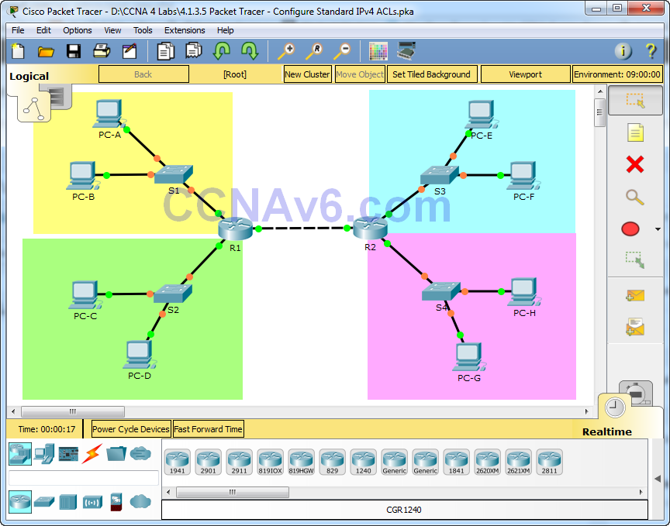
Topology

Slide 61
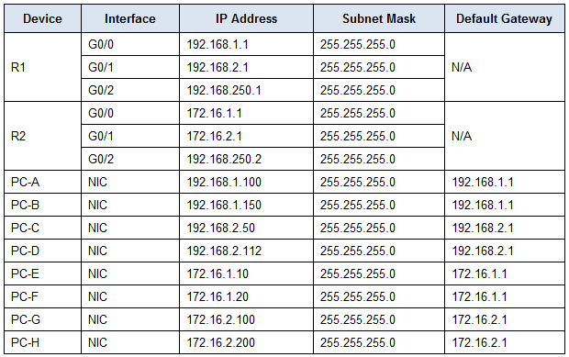
Addressing table

Slide 62
Objectives and background
Objective
Restrict traffic on the network by configuring standard IPv4 ACLs.
Background
An organization has recently decided to restrict traffic using standard IPv4 ACLs.
As the network administrator, it is your job to configure two standard IPv4 ACLs to restrict traffic to the Pink LAN and the Blue LAN (see PT Topology Diagram).
You must also configure a named standard IPv4 ACL to restrict remote access to router R1.
Router interfaces and default/static routes have already been configured.
Remote SSH access has also been enabled on the routers.
You will need the following access information for console, VTY, and privileged EXEC mode:
Username: admin01
Password: ciscoPA55
Enable secret: secretPA55

Slide 63
Part 1: Configure a Standard IPv4 ACL to Restrict Access to the Pink LAN
In Part 1, you will configure and apply access list 10 to restrict access to the Pink LAN.
Step 1: Outline what you wish to accomplish with access list 10.
Access list 10 should have 4 access control entries to do the following:
Access list 10 should start with the following comment: ACL_TO_PINK_LAN
Permit PC-C to reach the Pink LAN
Permit only the first half of hosts on the Yellow LAN, so they can reach the Pink LAN
Permit all of the hosts on the Blue LAN to reach the Pink LAN
Access list 10 should be configured on the correct router, and applied to the correct interface and in the right direction

Slide 64
Part 1: Configure a Standard IPv4 ACL to Restrict Access to the Pink LAN
Step 2: Create, apply, and test access-list 10.
After configuring and applying access list 10, you should be able to execute the following network tests:
All pings from hosts in the Pink LAN should be successful, but a ping from PC-B should be denied.
A ping from PC-C to a host in the Pink LAN should be successful, but a ping from PC-D should be denied.
Pings from hosts in the Blue LAN to hosts in the Pink LAN should be successful.
What message is sent back to the PCs when a ping is denied due to an ACL?
A destination unreachable message.
Which IP addresses on the Yellow LAN are permitted to ping hosts on the Pink LAN?
______________________________________________________________________
Access list 10 permits pings to the Pink LAN from hosts 192.168.1.1 to 192.168.1.127 on the Yellow LAN.

Slide 65
Part 2: Configure a Standard IPv4 ACL to Restrict Access to the Blue LAN
In Part 2, you will configure and apply access list 20 to restrict access to the Blue LAN.
Step 1: Outline what you wish to accomplish with access list 20.
Access list 20 should have 3 access control entries to do the following:
Access list 20 should start with the following comment: ACL_TO_BLUE_LAN
Deny the Yellow LAN from reaching the Blue LAN
Allow all other networks to reach the Blue LAN
Access list 20 should be configured on the correct router, and applied to the correct interface and in the right direction.

Slide 66
Part 2: Configure a Standard IPv4 ACL to Restrict Access to the Blue LAN
Step 2: Create, apply, and test access-list 20.
After configuring and applying access list 20 you should be able to execute the following network tests:
Pings from all other hosts in the Yellow LAN to the Blue LAN should fail.
Pings from hosts in the Green and Pink LANs to the Blue LAN should be successful.
Step 3: Insert an ACE into access-list 20.
You need to make a change to access list 20. Insert an access control entry into access list 20 to permit PC-A to reach the Blue LAN. Insert the ACE prior to the other access list 20 permit and deny access control entries.
How do you insert or remove an ACE into a specific line of an ACL?

Slide 67
Part 3: Configure a Named Standard IPv4 ACL
In Part 3, you will configure and apply a named standard IPv4 ACL to restrict remote access to router R1.
Step 1: Outline what you wish to accomplish with named standard ACL.
The named access list should do the following:
On R1 create a standard ACL named ADMIN_VTY
Permit a single host, PC-C
Apply the ACL to the VTY lines
Step 2: Test access-list ADMIN_VTY.
After configuring and applying access list ADMIN_VTY, you should be able to execute the following network test:
An SSH connection from host PC-C to R1 should be successful.
SSH connections from all other hosts should fail.
Reflection
This lab features two standard ACLs to restrict traffic to the Pink and Blue LANs. Could you create 2 more standard ACLs to restrict traffic to the Yellow and Green ACLs and which router would those ACLs need to be created on?

Slide 68
solution

Slide 69
script
R1
ip access-list standard ADMIN_VTY
permit 192.168.2.50
line vty 0 4
access-class ADMIN_VTY in
R2
access-list 10 remark ACL_TO_PINK_LAN
access-list 10 permit host 192.168.2.50
access-list 10 permit 192.168.1.0 0.0.0.127
access-list 10 permit 172.16.1.0 0.0.0.255
access-list 20 remark ACL_TO_BLUE_LAN
access-list 20 permit host 192.168.1.100
access-list 20 deny 192.168.1.0 0.0.0.255

Slide 70
https://itexamanswers.net/4-1-3-5-packet-tracer-configure-standard-ipv4-acls-answers.html

